Slide 1
Introduction to Flow Matching
Presenter: Kim Seung Hwan (seunghwan.kim@snu.ac.kr)
NCIA 인공지능 석사과정 25

Slide 2
Generative Model
What is the generative model?

Slide 3
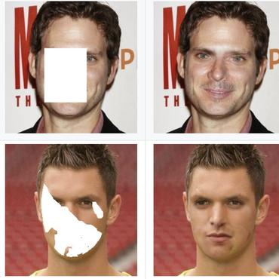
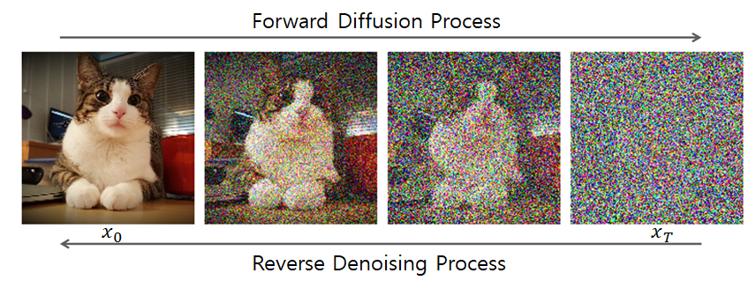
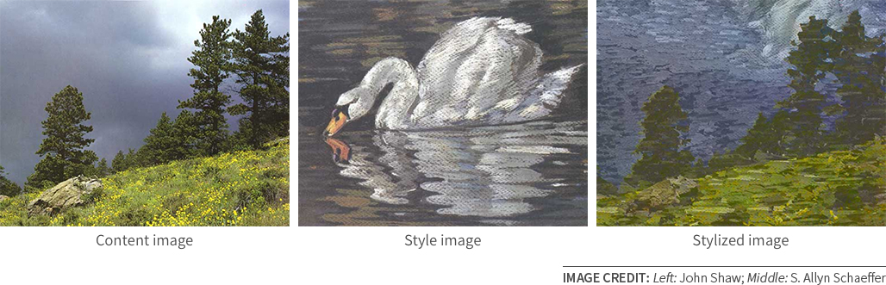
Generative Model
What is the generative model?
A mapping between probability distribution.
Stylization
Sampling
Inpainting

Slide 4
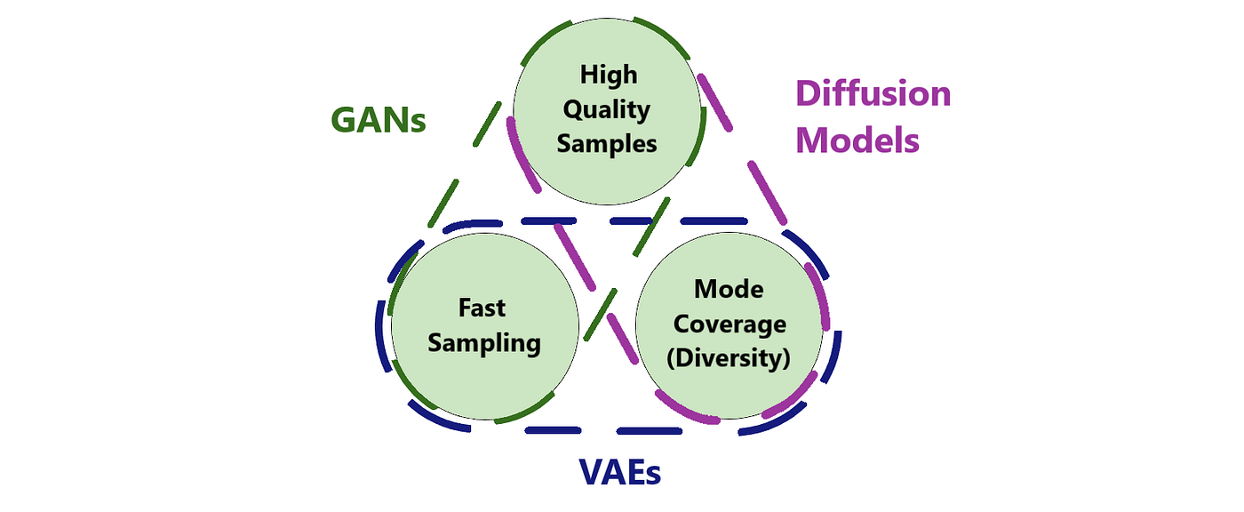
Architecture
There is a trade-off!

Slide 5
Architecture
There is a trade-off!

Slide 6
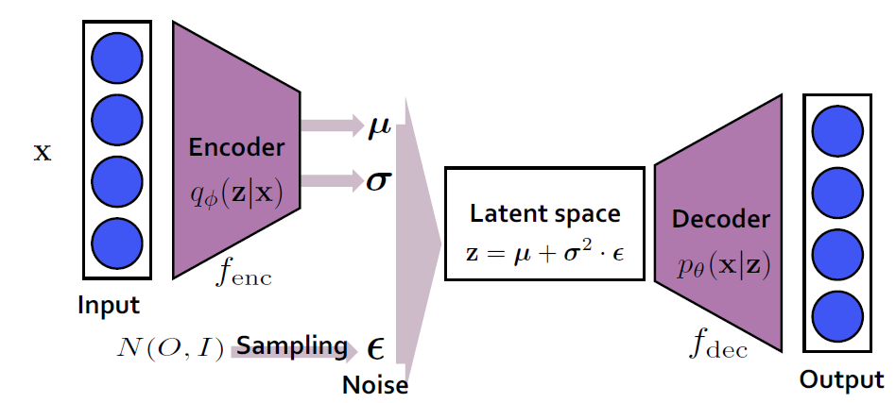
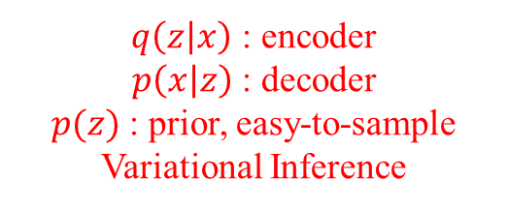
Variational Autoencoder
Is not only simple but also attractive from a theoretical perspective
Good at downstream tasks, since it does “compression.”
e.g. generating embedding which is semantically orthogonal, etc.
Very easy and cheap
BUT poor performance…
$q\left(z | x\right)$ : encoder
$p\left(x | z\right)$ : decoder
$p(z)$ : prior, easy-to-sample
Variational Inference

Slide 7
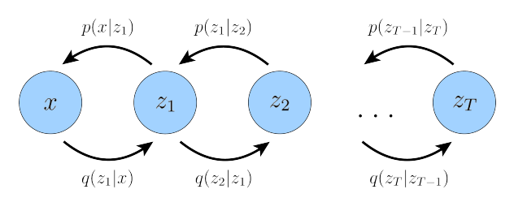
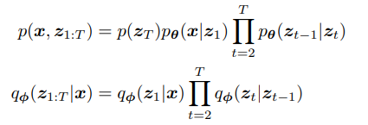



Diffusion Model
Splendid performance with well-designed modeling
Currently crowded field
BUT expensive to train
Popular field can be a disadvantage
$$q\left(x_{t} | x_{0}\right)∼N$$
$$q\left(x_{t} | x_{t−1}\right)∼N$$
Since $X∼N;Y∼N$
$$→X+Y∼N$$
Because it’s Markov chain!

Slide 8
Flow Model
Flow model is something in between
It starts from VAE, so it is very simple
While generalizing diffusion
Also, there is still a lot of room for improvement (at least in my op.)

Slide 9
Introduction to Flow Model
In fact, the flow model was proposed quite a long time ago
But it did not gain popularity because of the limitation of requiring the inverse (quite strong constraints!)
It has recently overcome this limitation and shown strong performance
We will look at the development process of the flow model

Slide 10

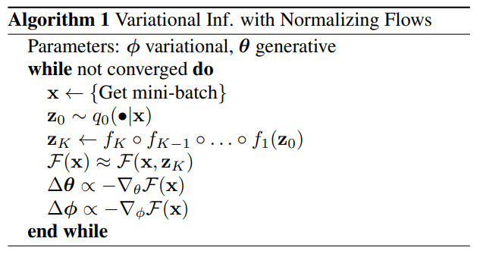
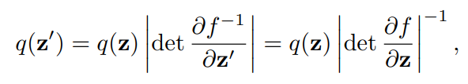
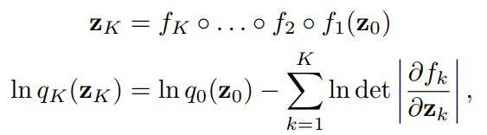

Normalizing Flow
Variational inferences using VAE suffers approximation error
e.g. mean-field approx. $q\left(z | x\right)=\prod_{i}{q(z_{i}|x)}$
Propose training diffeomorphism $f:ℝ^{n}$ (prior) $→ℝ^{n}$ (data)
typically, resulting in $q\left(z | x\right)∼N\left(μ\left(x\right),diag\left(σ\left(x\right)\right)\right)$
Rezende, Danilo, and Shakir Mohamed. "Variational inference with normalizing flows." International conference on machine learning. PMLR, 2015.

Slide 11
Thank you for listening
Presenter: Kim Seung Hwan (seunghwan.kim@snu.ac.kr)
NCIA 인공지능 석사과정 25

